Slide 1

The changing face of Business Analysis in a digital world
Ian Holloway
May 2020
Notes:
I’m Ian Holloway and I’ve been asked to share with you my experience as a BA, , how I became a BA, to where I am now, as well as what I think about the role of a Business Analyst in the every changing digital world
As I go through the slide I shall try and make sure I explain any technical terms or jargon, however if I do use a word, or you see something on the deck that you’d like to know more about, please drop a note in the question box and Jonathan will ask me, and I’ll make sure I either cover at the end, or as we go!

Slide 2
What is digital?
0 or 1
Off or On
No or Yes
Notes:
4 min- ask the audience
So lets start with discussing what we think Digital is, please use the chat box
Digital is a term we hear all the time
For me it’s the latest in a long line of over used buzz words, think virtual, cloud, automation, robotic to name but a few
In my experience digital normally means a fairly light touch customer experience, be it a self serve website or app, maybe an IVR, but if you look a the bits and bytes level most things related to IT are digital

Slide 3
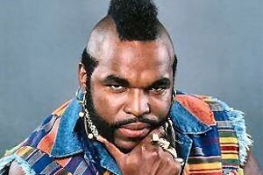
What is a ba?
What do you all think?
💬 Translator, Influencer, Thinker, Facilitator
💬 Conduit between business/technology
💬 The person with the post it notes
💬 Translator, facilitator
Notes:
4 mins
I asked my current team of Bas 3 questions, and have shared some of their responses here
Fairly common themes, if we have the capability on the phone, please feel to add any to the chat

Slide 4
What did you do before you became a BA?
💬 Sales Team Manager managing small and medium accounts for corporate clients
💬 I was a Business & Economics Secondary School Teacher
💬 PM/Coordinator roles covering all sorts of changes; infrastructure, data centre migrations, work area recovery, relocations, web development..
💬 Quality Management, Auditing and Trouble Shooting in Commercial Automative
💬 Started as a Coder and than shifted to application support and gradually transitioned into BA role.
💬 Retail store manager
💬 Call Centre agent
Notes:
2
Show the different routes into the role, I’m going to focus on 2 roles in particular, the retail store manager and call centre agents
These are people who I worked with at EE, they both undertook a short work experience programme we had developed, and then applied for open roles

Slide 5
What does the future hold? What would you like to be doing in 10 years?
💬 Driving business strategy at a Group level
💬 Lead BA / BA Manager or stepping over to the dark side of project/programme management.
💬 Something different to analysis, leading a change department
💬 Sustainability inline with the latest tech unsure of the role title
💬 Product owner/Senior product owner
Notes:
2
Some of the team want to continue as being a BA but others are looking to move into different roles, I think this is also dependant on the company you are working for
A product owner is normally a main stakeholder for a BA, it’s the face of “the business” it’s the person you are helping understand the problem

Slide 6




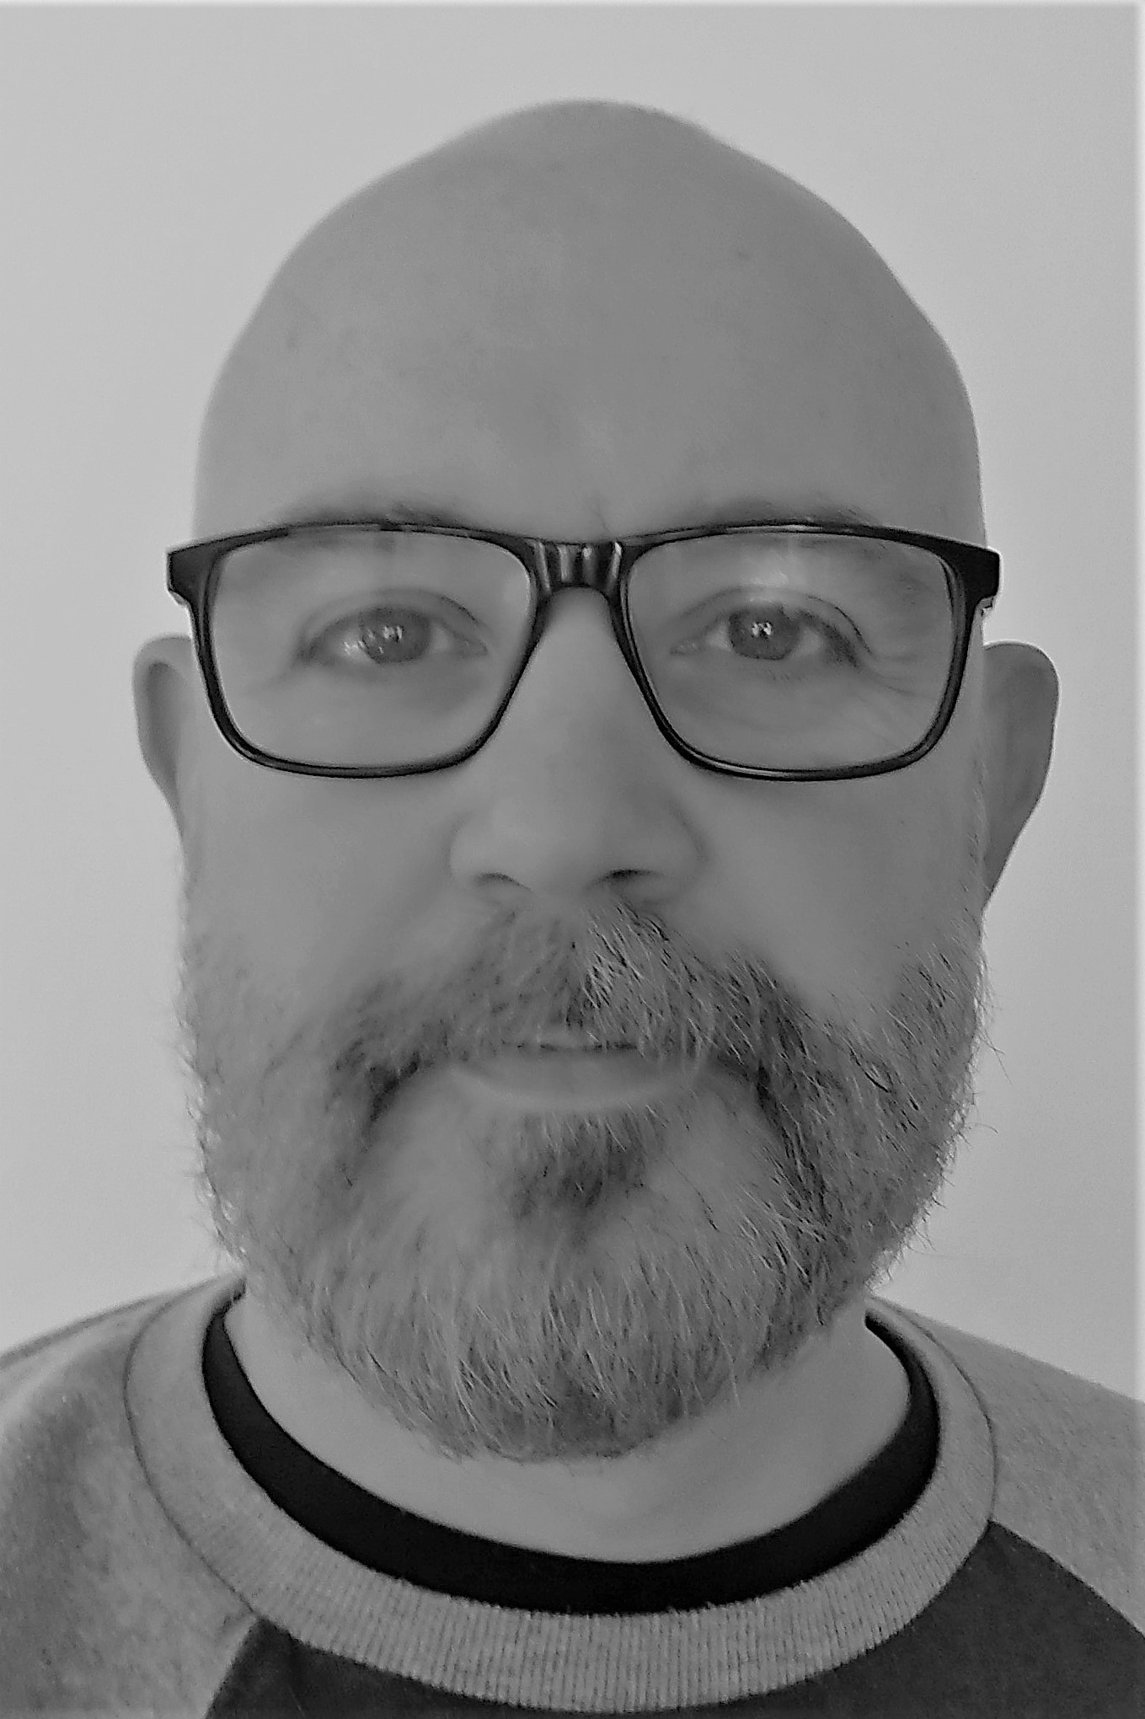




My Journey: before, during and after being a BA
https://www.linkedin.com/in/hollowayian/
Notes:
3
Ericsson- the boom of IT And the internet, late 90s, started using scanners to send electronic copies of invoices around he company for approval rather than internal mail, started to use email to communicate!
Move to Brighton, became an accountant, but got heavily involved in the financial reporting systems, firstly as an end user, doing acceptance testing, then doing training, then when we developed a WAP phone credit control system I became a fully fledged BA, although didn’t really know what it was, but enjoyed what I was doing!! I got to travel around Europe with a company credit card, in my early 20s!!
As we go through this discussion I think this theme of how people become BAs will be repeated, as the business aspect is much harder to teach, compared with the analyst side.
Philips- well off shoot, head hunter to move to holland as a contract BA, doing what I’d just done for ericsson in Europe, for them across the world, but without the travel, so lots of citrix demos and conference calls!!
Came back to the UK as the company was sold off, and all contracts let go and landed a job after a couple of months with O2 in Leeds again as a contract BA, working on an emoney project, which was early 2000’s and was so far ahead of it’s time it was incredible, imaging using your phone to pay for goods and services? Yup we thought of apple pay before apple did, but the banks wouldn’t let us develop the product, so I moved into DWH again, and then progressed into project management (didn’t really like it) into architecture (liked it) and final got to try my hand at line management, for a team of architects, designers and BA’s. this was my first step into line management and I really enjoyed it, I lead the reporting work steam for the launch of the original iphone. At the same time I’d met the future Mrs holloway, and soon after we got married we talked about working overseas, so I updated my linkedin profile and a few weeks later got a call from Orange in swtitzerland
I became a business architect, which isn’t a common role, but it’s like a turbo charged BA, working at director level to help define you ideas for the business, rather than just focusing on IT. After a couple of years at Orange I was ready for a change, and heard about a job coming up at UEFA, this was only the 2nd time I’d applied for a role, was beat around 1500 other applicants to become the Solution design and architecture manager
After a couple of years of bribery and corruption my wife and I decide it was timet o move back to the uk, where I landed a job with Capita working on the outsource customer service contract for O2, this was great to work with old friends, even if I was a supplier into the ,and I quickly progressed through to lead architect on the account, then 6 months later I became head of architecture for all the major change programmes across 4-5 big accounts, names like O2, CPW, Npower, John Lewis,
Head hunter came calling again after 2 years and I moved to EE, initially looking after the digital architects, then I was asked to bring the solution designers into the mix, before finally the project managers, release managers, PMO and agile coaches reporting into me. It was a great time to be at EE, and we delivered a huge amount of change on the website, both for sales, but also account eself serve, and for me that’s the 2 main areas of digital 1. you can sell to your customer, very easily and once they are a customer they can self serve on an app or a website, without having to call in or visit a store (unless they want to) and if the do want to the experience and treatment should be the same as they would receive online.
All good things come to an end, and Talk Talk came knocking, where I now head up the analysis and design team across the full IT stack, with around 40 Bas and 50 solution design and architecs.

Slide 7
My Journey: before, during and after being a BA
Company | Role | Accounting, | Budgeting | Stakeholder management | Requirement Gathering | Process Mapping | Testing | Architecture | Process Improvements | Running Workshop | Project Management | Business Strategy | Line Management | Insights Analysis
Ericsson | Accountant
 | BA
Philips | BA
O2 | BA
 | Project manager
 | Architect
 | Team manager
Orange | Business Arch.
UEFA | Team manager
Capita | SA
 | Head of Dept.
EE | Head of Dept.
TalkTalk | Head of Dept.
Notes:
5
Hopefully this won’t mess with your eyes, but starts to show how the skills I developed as a BA have stood me in good sted for later roles in my career
This has helped me to build the BA practices in a number of different organisations,

Slide 8
The future for the role
Notes:
Its hard to predict the future, but

Slide 9
Do any of these sound familiar?
💬 Will Product owners replace the need for a BA?
💬 We are Agile, we don’t need a BA
💬 We don’t need Bas we can just build stuff, it’s much quicker and easier
💬 They spend far too long writing things down
💬 They aren’t technical
Notes:
5
2 examples- 1 working with a friend in Switzerland looking at how to grow his business, looking at the products they sold, which ones made the profit, then looking at which customer had which products, and the GAP was the plan to help sell more profitable products to customer,
Another example Paul and his website, he was speaking directly with a developer, they aren’t right or wrong they are just different
Also important to note, it’s not about being an introvert or an extrovert, but you have to be self aware

Slide 10
Skills Needed to build digital solutions
A sound understanding of how a business works
Ability to listen, question and get to the source of the problem, and not just what someone thinks they want
An interest in doing new things, and looking for ways something can be improved
Good at networking, this helps build a better understanding of a business
Notes:
All of the above skills are what I’d consider core BA skills, so what ever the name of the role is, people who have these skills, or some and desire to learn the others will have a very bright future

Slide 11

You can have a nice holiday in France without speaking French, But would you spend € 100k+ if you didn’t speak the language?
Notes:
Its hard to predict the future, but I’

